Slide 2
Summarize refined game target

Slide 3
Vertical slice scope

Slide 4
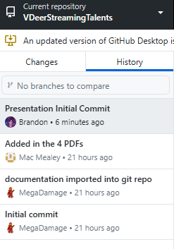
Demonstrate docs are complete
Everything document wise is stored in the repo.
Everything is updated as of recent.

Slide 5
Schedule
Programming
Artwork
Company Quota System (1 week)
Streaming System (1-2 weeks)
Real Life / Apartment Area (1-2 weeks)
Stream Chat System (1-2 weeks)
Stream decisions/setup (1-2 weeks)
Rent / Expenses and revenue (1-2 weeks)
Collab System and Socialization (1-3 weeks)
3D Vtuber Models (1-4 weeks)
Streaming UI (1 week)
Apartment Area Models (1-4 weeks)
2D Vtuber Art (1-4 weeks)
Narrative
Writing for Streaming/Partner/Collabs (During the whole development)
Narrative to Game (During the whole development)

Slide 6
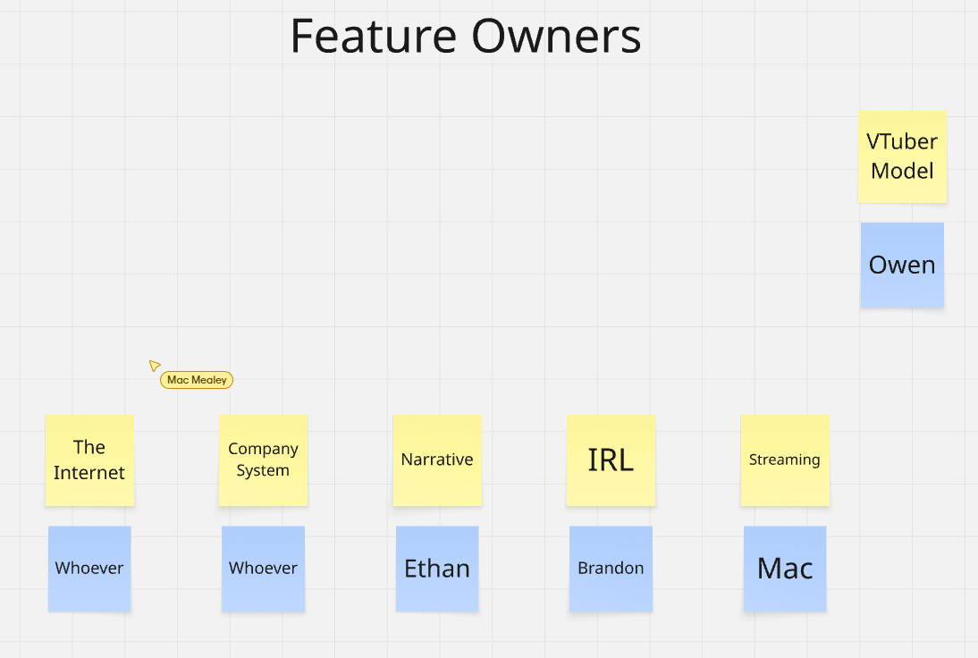
Ownership

Slide 7
Risks
Project Risks:
Over scope due to the number of features.
  Must cut down or revise features
Loss in game direction
  Narrative is not clear where the story is going
  Conflicting game directions for different features
Balancing issues to the games management mechanics.

Slide 8
PoC Demo

Slide 9
Prototyping validation results

